Slide 1
Wine Quality Prediction
-S Sai Abhiram Goud

Slide 2
Introduction:
For this project, I used Kaggle’s Red Wine Quality dataset to build various classification models to predict whether a particular red wine is “good quality” or not. Each wine in this dataset is given a “quality” score between 0 and 10. For the purpose of this project, I converted the output to a binary output where each wine is either “good quality” (a score of 7 or higher) or not (a score below 7).
The quality of a wine is determined by 11 input variables:
Fixed Acidity
Volatile Acidity
Citric Acid
Residual sugar
Chlorides
Free sulfur dioxide
Total sulfur dioxide
Density
Ph
Sulfates
Alcohol

Slide 3
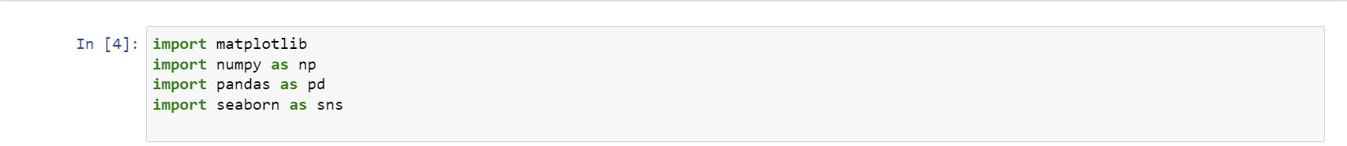
Objectives:
The objectives of this project are as follows
To experiment with different classification methods to see which yields the highest accuracy
To determine which features are the most indicative of a good quality wine
Setup:
First, I imported all of the relevant libraries that I’ll be using as well as the data itself.
Importing Libraries:
Reading Data:

Slide 4
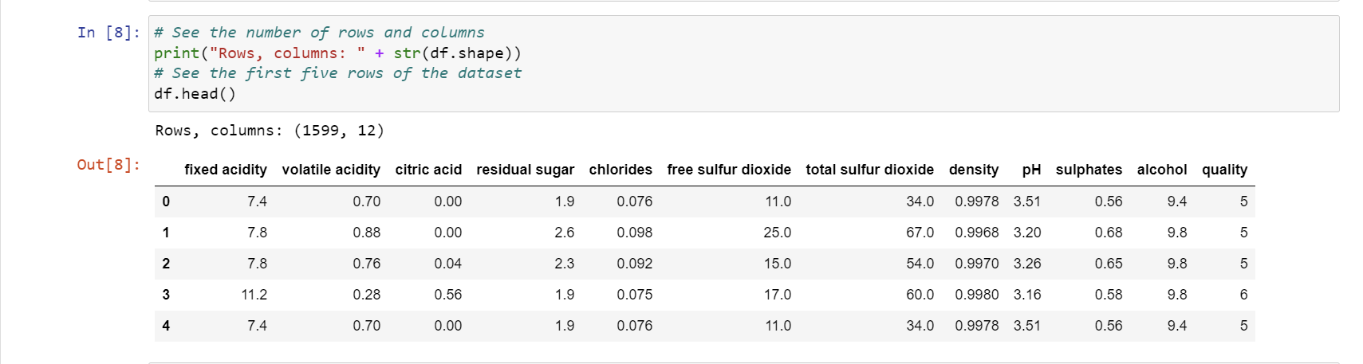
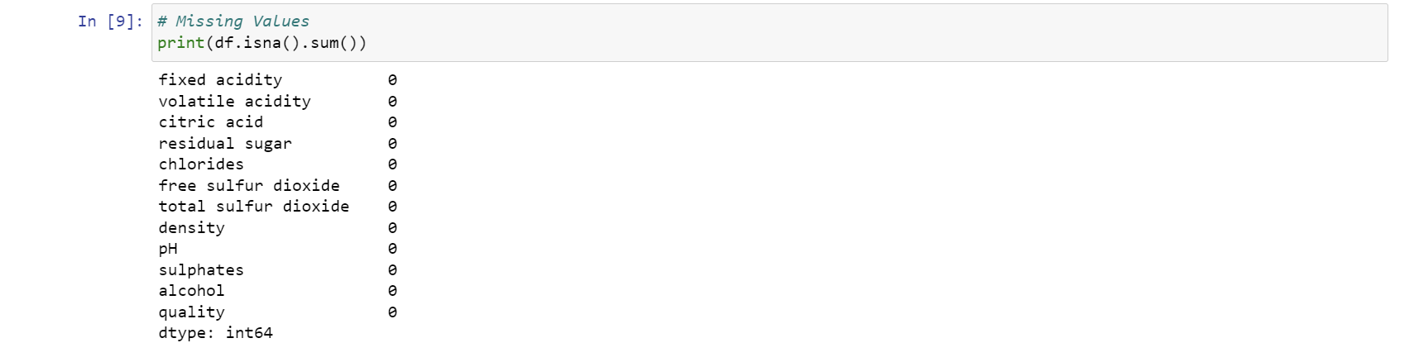
Understanding Data:
Next, I wanted to get a better idea of what I was working with.
There are a total of 1599 rows and 12 columns. The data looks very clean by looking at the first five rows, but I still wanted to make sure that there were no missing values.
Missing Values:

Slide 5
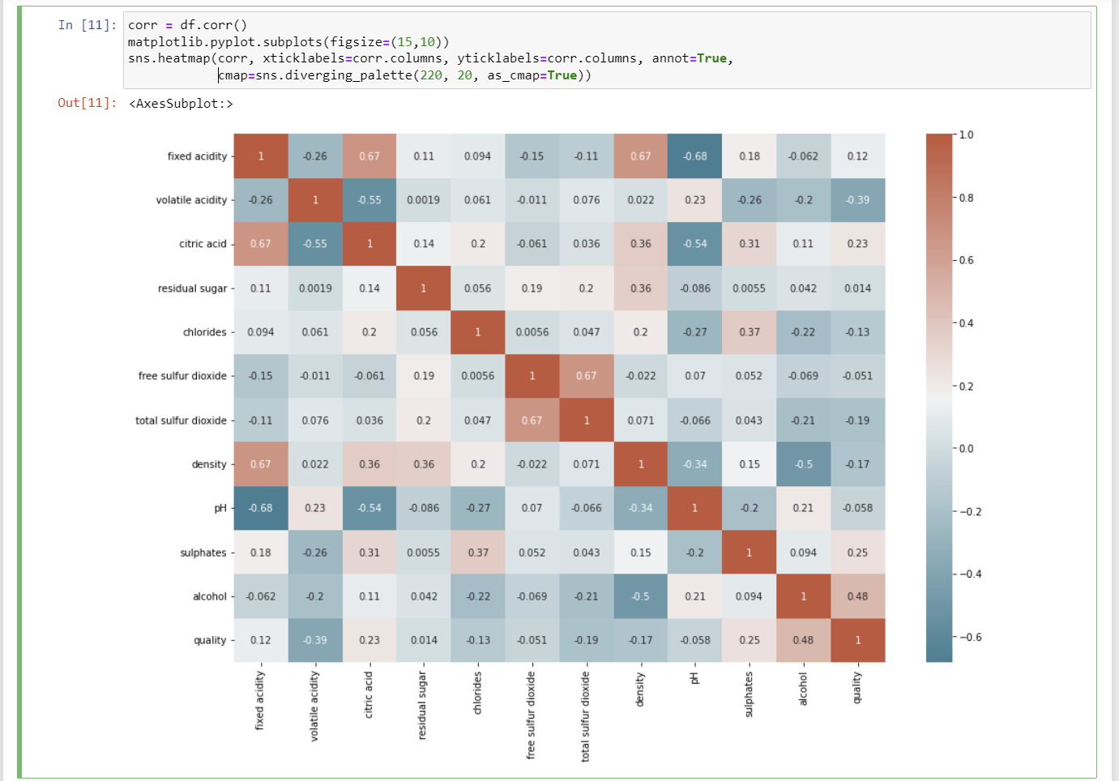
Correlation Matrix:
Next, I wanted to see the correlations between the variables that I’m working with. This allows me to get a much better understanding of the relationships between my variables in a quick glimpse.
Immediately, I can see that there are some variables that are strongly correlated to quality. It’s likely that these variables are also the most important features in our machine-learning model, but we’ll take a look at that later.

Slide 6
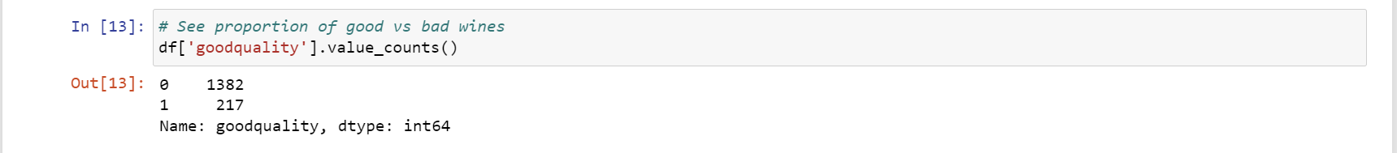
Convert to a Classification Problem:
Going back to my objective, I wanted to compare the effectiveness of different classification techniques, so I needed to change the output variable to a binary output.
For this problem, I defined a bottle of wine as ‘good quality’ if it had a quality score of 7 or higher, and if it had a score of less than 7, it was deemed ‘bad quality’.
Once I converted the output variable to a binary output, I separated my feature variables (X) and the target variable (y) into separate data frames.
The proportion of Good vs Bad Wines:
I wanted to make sure that there was a reasonable number of good quality wines. Based on the results below, it seemed like a fair enough number. In some applications, resampling may be required if the data was extremely imbalanced, but I assumed that it was okay for this purpose.

Slide 7
Standardizing Feature Variables:
At this point, I felt that I was ready to prepare the data for modeling. The first thing that I did was standardize the data. Standardizing the data means that it will transform the data so that its distribution will have a mean of 0 and a standard deviation of 1. It’s important to standardize your data in order to equalize the range of the data.
For example, imagine a dataset with two input features: height in millimeters and weight in pounds. Because the values of ‘height’ are much higher due to its measurement, a greater emphasis will automatically be placed on height than weight, creating a bias.
Split data:
Next, I split the data into a training and test set so that I could cross-validate my models and determine their effectiveness.

Slide 8
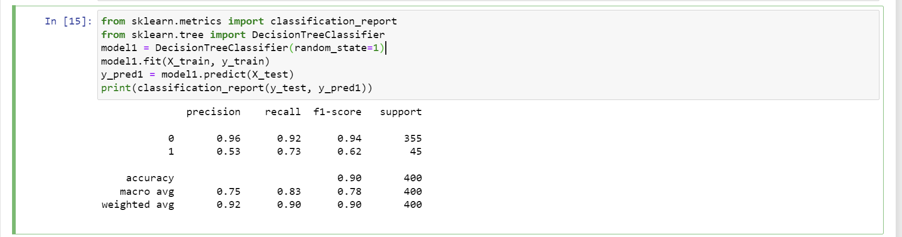
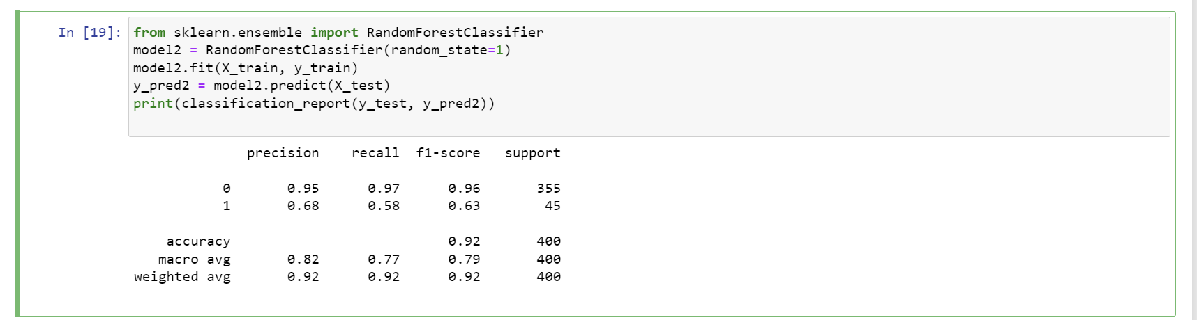
Modeling:
For this project, I wanted to compare five different machine learning models: decision trees, random forests, AdaBoost, Gradient Boost, and XGBoost. For the purpose of this project, I wanted to compare these models by their accuracy.
Model 1-Decision Tree:
Model 2-Random Forest:

Slide 9
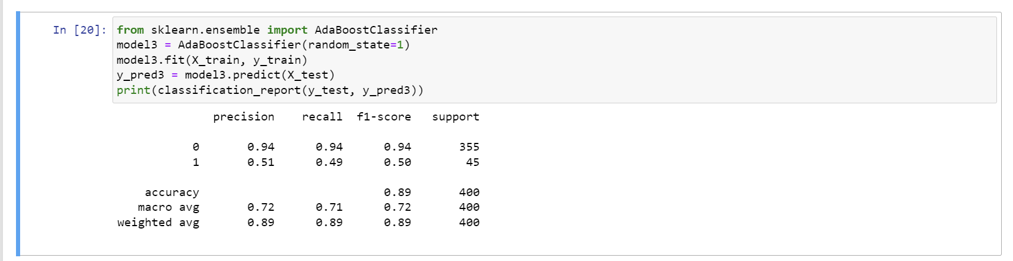
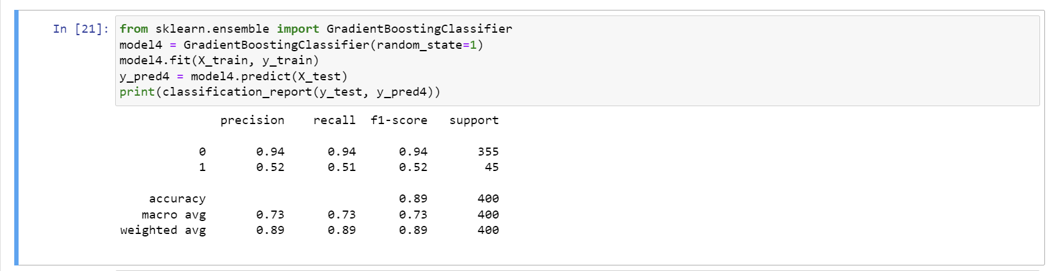
Model 3-Ada Boost:
Model 4-Gradient Boost:

Slide 10
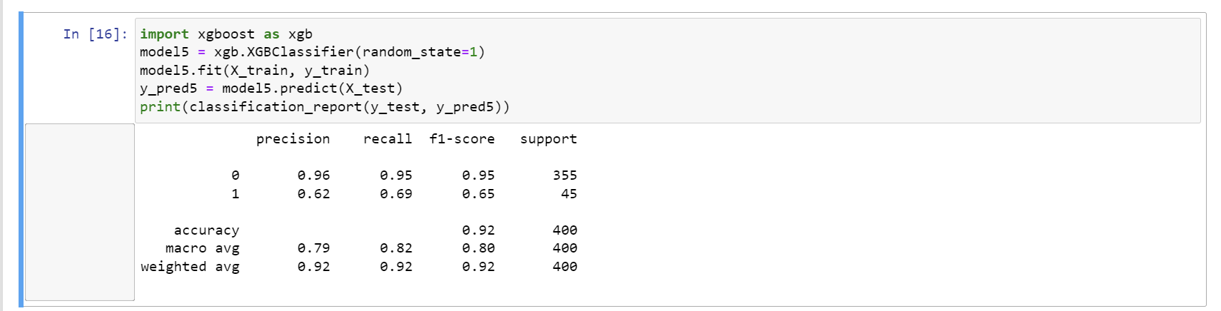
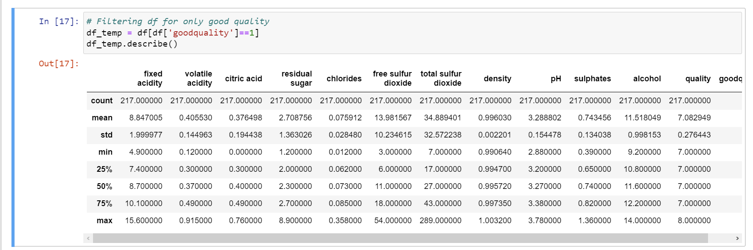
Model 5-XGBoost:
Comparing the Top 4 Features:
For Good Quality Data:

Slide 11
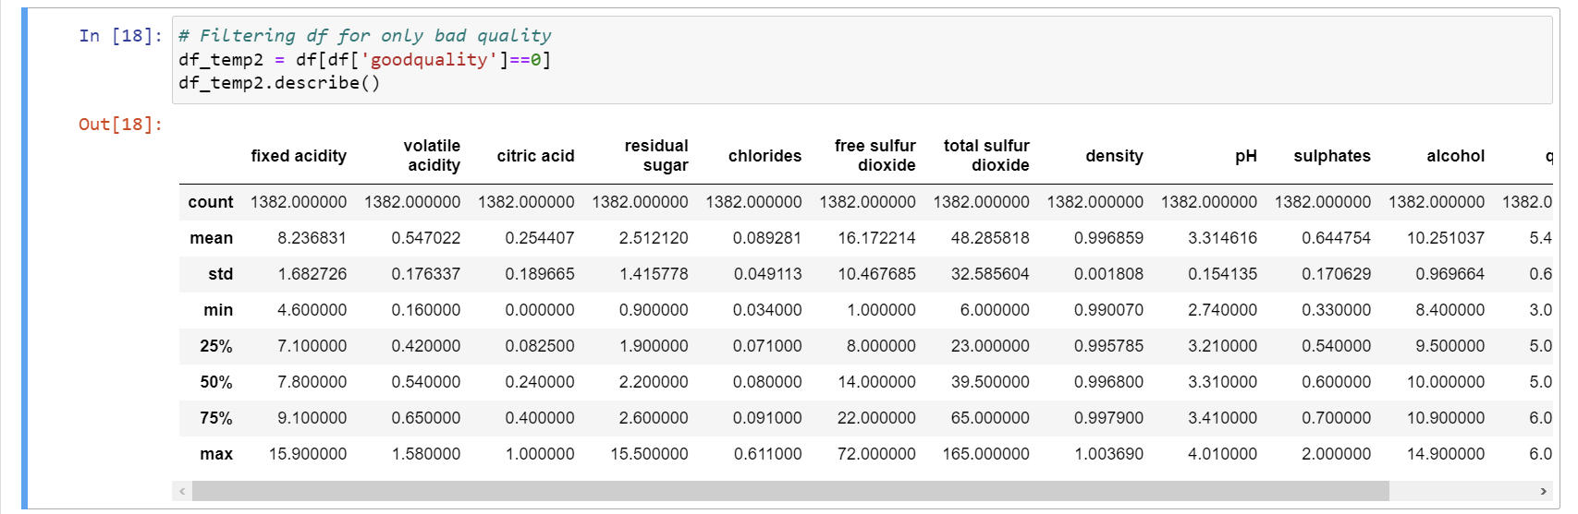
For Bad Quality Data:
By looking into the details, we can see that good quality wines have higher levels of alcohol on average, have a lower volatile acidity on average, higher levels of sulfates on average, and higher levels of residual sugar on average.

Slide 12
Thank You

